Slide 1
Definitions
Spatial Reference System (SRS)
  Same as “Coordinate System” in ArcMap
    Esri uses both at “Projection” to refer to an SRS
Geographic Coordinate System (GCS)
Projected Coordinate System (PCS)

Slide 2
Definitions
Datum – shape of the earth
  Typically contains a Spheroid
Coordinate System
  Cartesian or Rectangular
  Spherical (Geographic)
Projection – How to convert 3D to 2D
  Geographic or Un-projected
  UTM
  State Plane

Slide 3
Major Axis
Minor Axis
Inverse Flattening = Semi-Major Axis/ (Semi-Major Axis – Semi-Minor Axis)
Name | Semi-Major Axis | Inverse Flattening
WGS 84 | 6378137.0 | 298.257223563
WGS 72 | 6378135.0 | 298.26
NAD 27 | 6378206.4 | 294.9786982
NAD 83 | 6378137.0 | 298.257222101

Slide 4
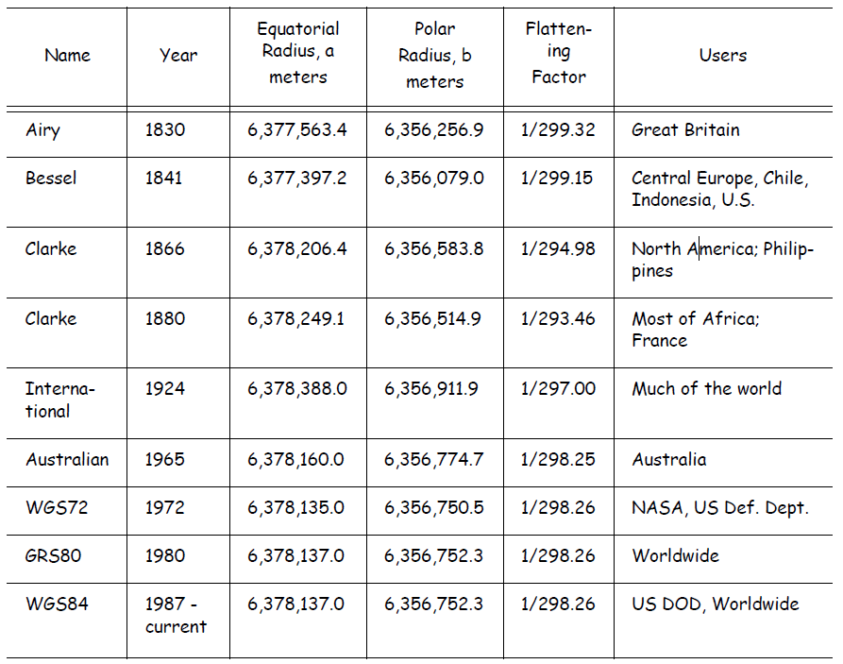
Notes:
Definitions for ellipsoids

Slide 5
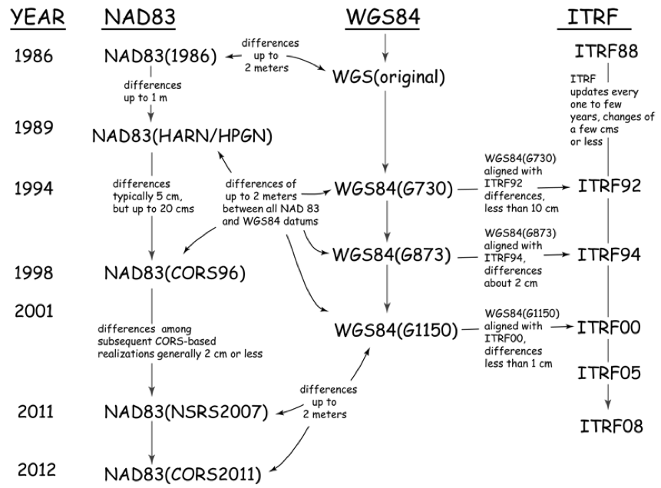
GIS Fundamentals, Paul Bolstad, University of Minnesota

Slide 6
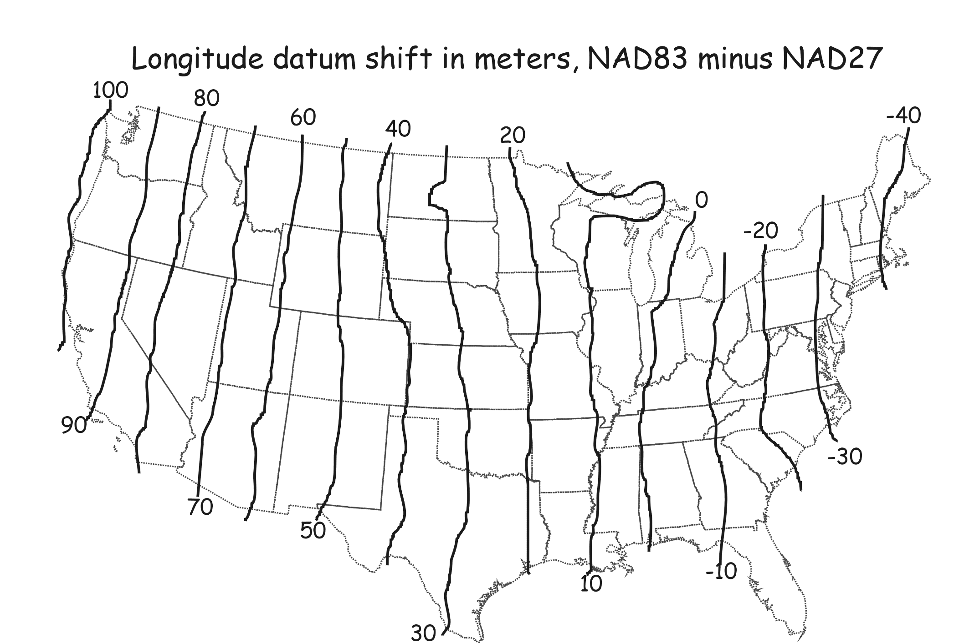
North-South Datum Shift

Slide 7
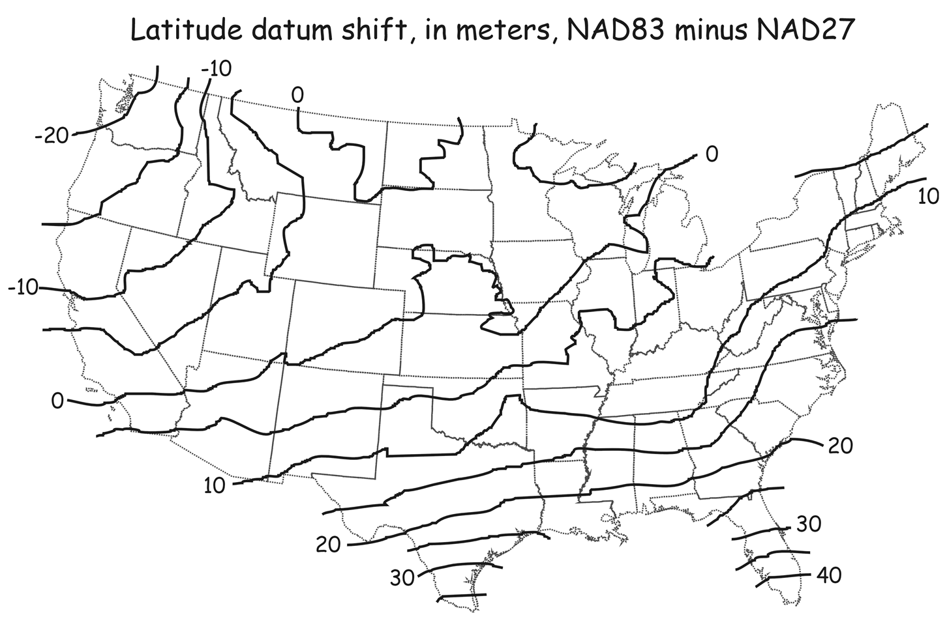
East-West Datum Shift
GIS Fundamentals, Paul Bolstad, University of Minnesota

Slide 8
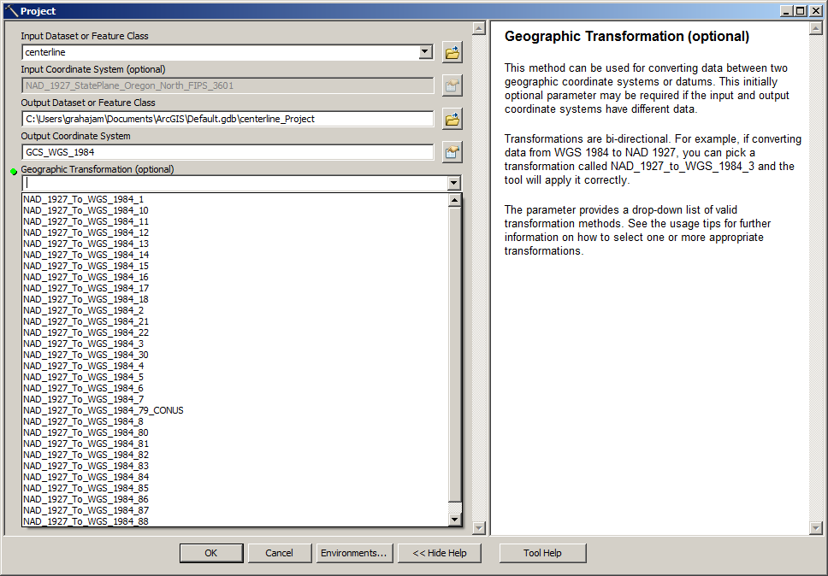
ArcGIS Datum Shifts
Picture of ArcGIS with geographic transform menu

Slide 9
Selecting a Datum Shift
Link ArcGIS’s website
http://blogs.esri.com/esri/arcgis/2009/05/06/about-geographic-transformations-and-how-to-choose-the-right-one/
Article with tables to select datum shift for each version of ArcGIS:
  http://support.esri.com/en/knowledgebase/techarticles/detail/21327
Jim’s Research Group Website:
  http://seer.science.oregonstate.edu/cwis438/Websites/EPSG/EPSG_Home.php

Slide 10
ArcGIS PRJ Files
Contain the SRS’s for defining and projecting data
Program Files
  ArcGIS
    Desktop 10.0
      Coordinate Systems
        Geographic Coordinate Systems
        Projected Coordinate Systems
        Vertical Coordinate Systems
Notes:
- “Geographic” only needs to be mentioned on a map when the data is presented as “Geographic” data

Slide 11
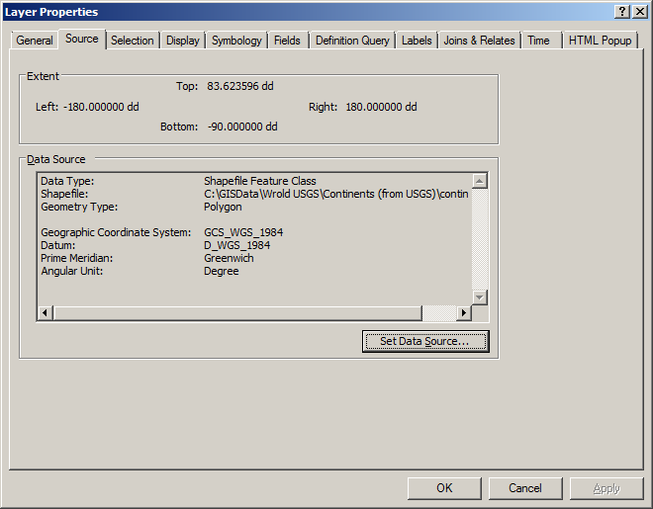
Shapefile Properties Dialog

Slide 12
WGS 1984 PRJ File Contents
GEOGCS["GCS_WGS_1984",
DATUM["D_WGS_1984",
    SPHEROID["WGS_1984",
      6378137.0,
      298.257223563
      ]
    ],
PRIMEM["Greenwich",0.0],
UNIT["Degree",0.0174532925199433],
AUTHORITY["EPSG",4326]
]

Slide 13
Natural Earth: PRJ File
GEOGCS["GCS_WGS_1984",
  DATUM["D_WGS_1984",
  SPHEROID["WGS_1984",
    6378137.0,298.257223563]],
  PRIMEM["Greenwich",0.0],
  UNIT["Degree",0.0174532925199433]]
http://docs.geotools.org/stable/javadocs/org/opengis/referencing/doc-files/WKT.html
Notes:
The units conversion is to radians
The values for the spheroid are in meters (major axis and flattening)

Slide 14
Projected Coordinate Systems
Continental
  North America
    North America Albers Equal Area Conic
    North America Lambert Conformal Conic
  State Plane
    NAD 1927 (US Feet)
    NAD 1983 (Meters)
  UTM
  World
  World (Sphere-based)

Slide 15
Oregon State Plane North
PROJCS["NAD_1927_StatePlane_Oregon_North_FIPS_3601",
  GEOGCS["GCS_North_American_1927",
    DATUM["D_North_American_1927",
      SPHEROID["Clarke_1866",6378206.4,294.9786982]],
    PRIMEM["Greenwich",0.0],
    UNIT["Degree",0.0174532925199433]],
  (continued on next slide)

Slide 16
Oregon State Plane North
Continued from previous slide:
  PROJECTION["Lambert_Conformal_Conic"],
  PARAMETER["False_Easting",2000000.0],
  PARAMETER["False_Northing",0.0],
  PARAMETER["Central_Meridian",-120.5],
  PARAMETER["Standard_Parallel_1",44.33333333333334],
  PARAMETER["Standard_Parallel_2",46.0],
  PARAMETER["Latitude_Of_Origin",43.66666666666666],
  UNIT["Foot_US",0.3048006096012192]]

Slide 17
Robinson (world)
  PROJCS["World_Robinson",
  GEOGCS["GCS_WGS_1984",…],
  PROJECTION["Robinson"],
  PARAMETER["False_Easting",0.0],
  PARAMETER["False_Northing",0.0],
  PARAMETER["Central_Meridian",0.0],
  UNIT["Meter",1.0],
  AUTHORITY["ESRI",54030]]

Slide 18
Projected Coordinate Systems
UTM
  WGS 1984
    Northern Hemisphere
      WGS 1984 UTM Zone 1N to 60N
    Southern Hemisphere
      WGS 1984 UTM Zone 1S to 60N
  NAD 1983
    NAD 1983 UTM Zone 1N to 60N

Slide 19
UTM, Zone 10 North
PROJCS["WGS_1984_UTM_Zone_10N",
GEOGCS["GCS_WGS_1984”,…],
PROJECTION["Transverse_Mercator"],
PARAMETER["False_Easting",500000.0],
PARAMETER["False_Northing",0.0],
PARAMETER["Central_Meridian",-123.0],
PARAMETER["Scale_Factor",0.9996],
PARAMETER["Latitude_Of_Origin",0.0],
UNIT["Meter",1.0],
AUTHORITY["EPSG",32610]]

Slide 20
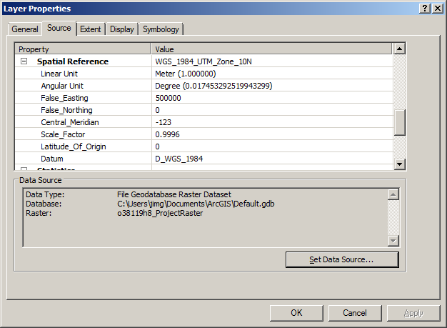
Raster Properties Dialog

Slide 21
Reference System Standards
European Petroleum Standards Group
  EPSG
Well Known Text Form
  WKT‏
Arc “projection” files
  PRJ (contains entire SRS)
Proj 4
  Projects and performs datum shifts

Slide 22
Geographic/Datum Transforms
International Association of Oil and Gas Producers:
  European Petroleum Survey Group (EPSG)
  http://www.epsg.org/
  53 Ellipsoids
  630 Datums (Ellipsoid plus prime meridian and units)

